Slide 1
Построение сводных отчетов в SAS с помощью PROC REPORT

Slide 2
PROC REPORT
Детальный отчет
PRINT
REPORT
TABULATE
Сводный отчет
Notes:
The REPORT procedure can create detail reports like PROC PRINT and can create summary reports like PROC TABULATE. But, we will see that the REPORT procedure has more power and flexibility than PRINT and TABULATE.

Slide 3
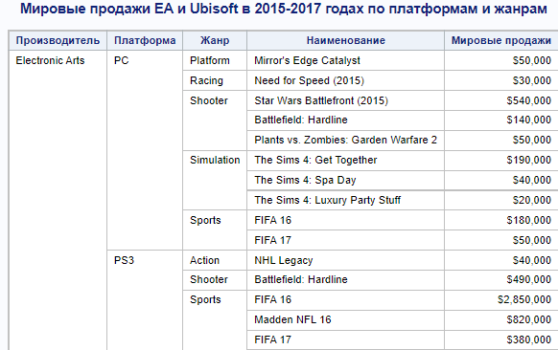
Детальный отчет
Детальный отчет отображает строки исходной таблицы
Notes:
Here’s an example of a detail report created with the PROC REPORT step. The majority of the rows correspond to an employee which is a row in the input table. For example, in Australia there are four employees in the Engineering department displayed as four rows in the report.

Slide 4
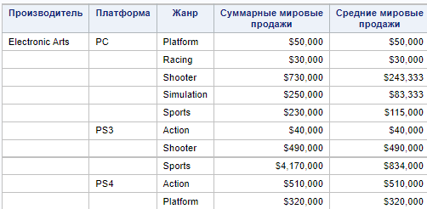
Сводный отчет
Сводный отчет содержит сгруппированные данные
Notes:
This is a summary report created with the PROC REPORT step. A row in this report corresponds to numerous rows from the input table. For example, in Australia, there are 13 salary values for the Administration department. Additionally, we are calculating the average, minimum, maximum, and total salaries for each country and department combination.

Slide 5
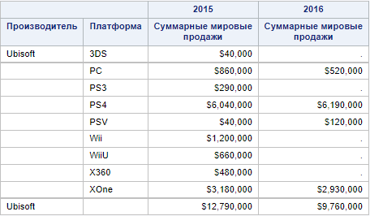
Строки итогов
Строки итогов позволяют вывести суммарные показатели по группе
Notes:
Within detail and summary reports, we can have summary lines. This is a similar concept to using the SUM statement in PROC PRINT or the ALL keyword in PROC TABULATE.

Slide 6
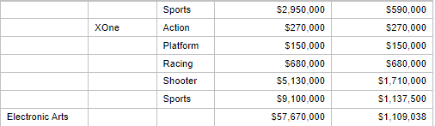
Оператор BREAK
BREAK BEFORE | AFTER break-column / <option(s)>;
Разделяет отчет на страницы для каждого уникального значения столбца
Notes:
The BREAK statement syntax is similar to RBREAK but has an extra item. After the keyword BREAK, you will specify BEFORE or AFTER. Then you must specify your break-column. The break-column must be a column with a usage of ORDER or GROUP. In other words, you are specifying at what breaking point you want to do a summarization. In these two examples, we are breaking on Country so before or after each country we get a summarization. Alternatively, we could have specified a break on Department which would have summarized after each Country and Department combination.

Slide 7
Роли столбцов
В PROC REPORT каждому столбцу может быть назначена одна из указанных ниже ролей.
Детальный отчет
DISPLAY
ORDER
Сводный отчет
GROUP
ACROSS
Одновременно
ANALYSIS
COMPUTED
Notes:
A major concept to understand with PROC REPORT is the concept of usages. Every report column is defined with a usage which tells SAS how to use that column within the report. There are six available usages. If you are creating a detail report, you will use the DISPLAY and ORDER usages. If you are creating a summary report, you will use the GROUP and ACROSS usages. Within one report, you cannot have a detail usage such as DISPLAY and a summary usage such as GROUP. It is either the detail usages or the summary usages. Two of the usages can be used with both detail or summary reports. ANALYSIS and COMPUTED usages work regardless of the type of report.

Slide 8
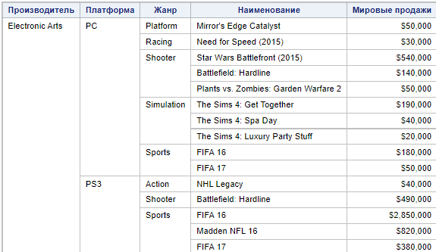
Роль DISPLAY
Детальный отчет
Роль DISPLAY отображает значения в их исходном виде (так, как они хранятся в таблице-источнике).
Notes:
In this detail report. The employee name and the hire date columns have a usage of DISPLAY. These two columns are displaying their values in the order dictated by the input table.

Slide 9

Роль ORDER
Детальный отчет
Роль Order определяет столбец, по которому данные будут отсортированы в отчете
Notes:
The country and department columns have a usage of ORDER. These columns are displaying values but they are in sorted order. Remember, PROC PRINT can’t sort data so you had to use PROC SORT first. That is not the case with PROC REPORT which has the ability to sort the data. When using the ORDER usage, repetitious printing of values is suppressed. In this example, the value of country applies to seven employees, four from Engineering and three from Sales Management.

Slide 10

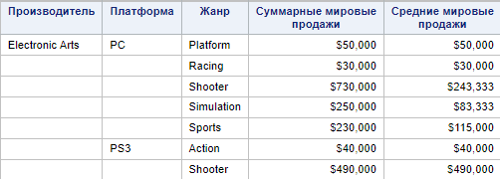
Роль GROUP
Сводный отчет
Роль GROUP позволяет определить группирующие столбцы, в рамках которых будет произведена дальнейшая агрегация числовых показателей.
Notes:
The GROUP usage is similar to the ORDER usage in the fact that it sorts the data. But the GROUP usage creates a summary report, not a detail report. It is collapsing rows of input data into summary rows. Repetitious printing of values is also suppressed for the GROUP usage. In this example, the country value of Australia applies to the five departments ranging from Administration to Stock & Shipping.

Slide 11
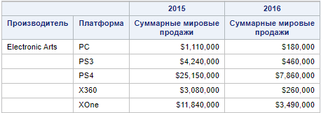
Роль ACROSS
Сводный отчет
Роль ACROSS позволяет определить столбцы в таблице вида матрицы. В рамках данных столбцов будут рассчитаны числовые статистики (по умолчанию количество значений)
Notes:
The GROUP usage is similar to the ORDER usage in the fact that it sorts the data. But the GROUP usage creates a summary report, not a detail report. It is collapsing rows of input data into summary rows. Repetitious printing of values is also suppressed for the GROUP usage. In this example, the country value of Australia applies to the five departments ranging from Administration to Stock & Shipping.

Slide 12
Роль ANALYSIS
Оба вида отчетов
Роль ANALYSIS позволяет задавать способ агрегации числовых столбцов
Notes:
The GROUP usage is similar to the ORDER usage in the fact that it sorts the data. But the GROUP usage creates a summary report, not a detail report. It is collapsing rows of input data into summary rows. Repetitious printing of values is also suppressed for the GROUP usage. In this example, the country value of Australia applies to the five departments ranging from Administration to Stock & Shipping.

Slide 13

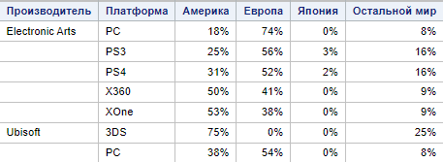
Роль COMPUTED
Оба вида отчетов
Роль COMPUTED позволяет задавать новые столбцы, вычисляемые с помощью выражений на основе существующих столбцов
Notes:
The GROUP usage is similar to the ORDER usage in the fact that it sorts the data. But the GROUP usage creates a summary report, not a detail report. It is collapsing rows of input data into summary rows. Repetitious printing of values is also suppressed for the GROUP usage. In this example, the country value of Australia applies to the five departments ranging from Administration to Stock & Shipping.

Slide 14
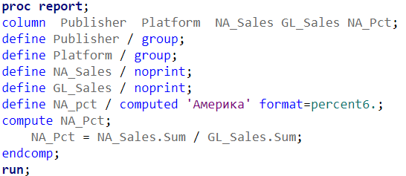
Создание вычисляемого столбца
Вычисляемый столбец должен быть указан в операторе COLUMN
Опция noprint подавляет вывод столбца в отчет, при этом столбец должен быть указан в операторе COLUMN, если он используется для расчета
Вычисляемый столбец должен быть определен
с ролью COMPUTED. Затем должен быть определен COMPUTED блок для вычисления
Notes:
Do realize that a computed column must appear in a COLUMN statement after a column used in the COMPUTE block expression. In this example, Bonus is based on Salary. Therefore, Salary must appear before Bonus in the COLUMN statement. If you don’t want to see Salary in the final report, you can use the NOPRINT on the DEFINE statement to not show Salary in the report.

Slide 15
PROC REPORT
Оператор COLUMN указывает порядок расположения столбцов в отчете.
PROC REPORT DATA=SAS-table <option(s)>;
COLUMN report-item-1 < … report-item-n >;
DEFINE report-item-1 / <usage> <options>;
DEFINE report-item-n / <usage> <options>;
RUN;
Оператор DEFINE позволяет задать роли и дополнительные атрибуты столбцов отчета.
На месте report-item должны быть указаны столбцы отчета
Notes:
With the PROC REPORT step, at a minimum, you need a PROC REPORT statement which names the input SAS table and a RUN statement. Optionally, you can add a COLUMN statement and multiple DEFINE statements. The COLUMN statement control which report items are in the report and the order of the report items. The COLUMN statement is similar to the VAR statement in PROC PRINT. However, the VAR statement only includes table columns but the COLUMN statement can reference table columns, computed columns, and statistics. For each item on the COLUMN statement, you can specify a DEFINE statement which describe how to use and display a report item.

Slide 16
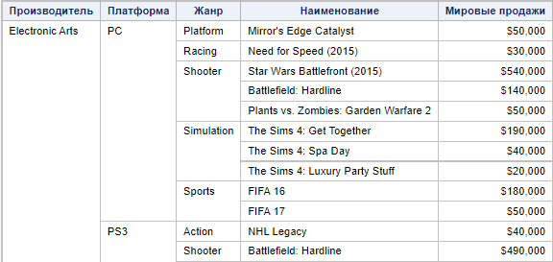
Роли по умолчанию
По умолчанию символьные столбцы имеют роль DISPLAY
Числовые столбцы по умолчанию имеют роль ANALYSIS со статистикой Sum
Notes:
It’s important to know that character columns automatically have a usage of DISPLAY which means a detail report will be created. Numeric columns automatically have a usage of ANALYSIS with a default statistic of SUM. This doesn’t have much impact in a detail report unless a summary line is added.

Slide 17
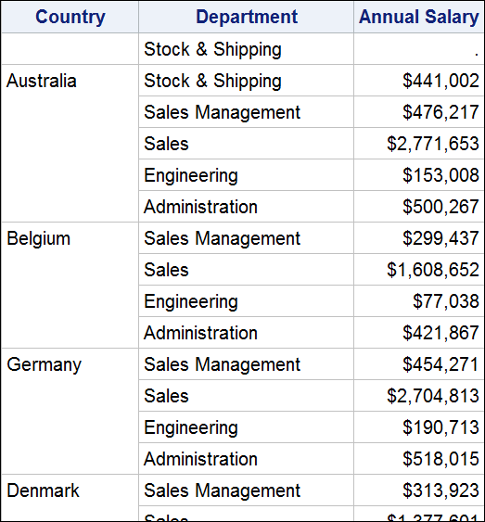
Дополнительные опции
MISSING
SPANROWS
DESCENDING
ORDER=INTERNAL
Notes:
Many of the same options we introduced when discussing the ORDER usage can be used with the GROUP usage. The MISSING option shows rows with missing values for the group columns. The SPANROWS removes the interior lines when repetitious printing is suppressed. The ORDER=INTERNAL option bases the sorting on the internal value and not the formatted value. The DESCENDING option sorts in descending order instead of the default order of ascending.

Slide 18
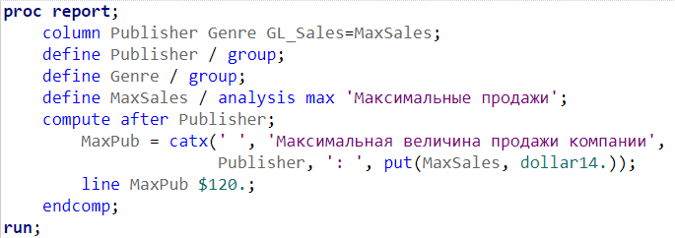
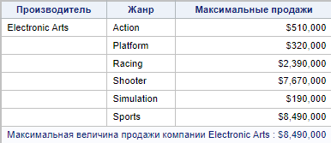
Дополнительные настройки итогов
Блок COMPUTE позволяет создавать кастомизированные итоги.
Notes:
Here’s the code it takes to accomplish this customized break line. On the DEFINE statement for SalMean, we will specify NOPRINT so the column doesn’t appear in the report but the column needs to exist to reference the value on the break line. In the COMPUTE block for after department, we will create a new column called Extra. Extra will concatenate the department value with a constant string and the SalMean value written with the DOLLAR14. format, a space will be concatenated between the arguments. Department will be set equal to a string of SubTotal for the standard summary line. Then the customized summary line will consist of the value of the Extra column. When a column is specified on the LINE statement it must be followed with a format.

Slide 19
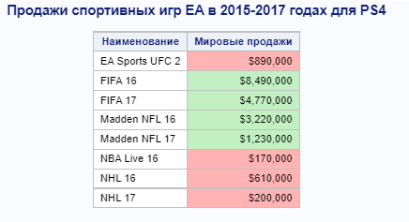
Условное форматирование
Опция STYLE= может быть добавлена в шаге PROC REPORT для указания стилей столбцов, что позволяет настроить условное форматирование.
Notes:
Trafficlighting is possible by adding STYLE= options in a PROC REPORT step. In this example, negative average salary difference values between Telework No and Telework Yes will have a salmon background. Non-negative average salary difference values will have a bisque background. Additionally, we will look to see how we can apply the concept of trafficlighting to achieve hyperlinks for the JobTitle values.

Slide 20
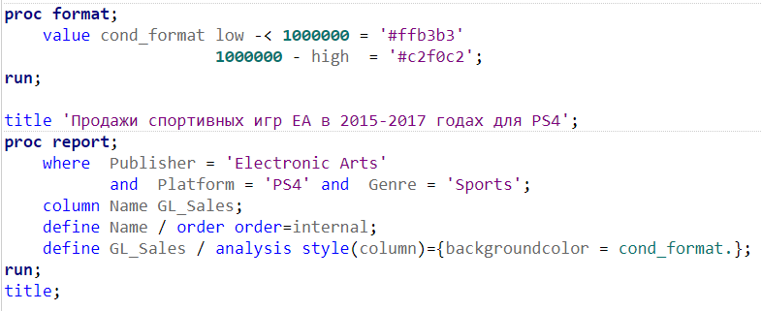
Опция STYLE=
STYLE(location)={ style-attribute-specification(s) }
Notes:
In this example, we are creating a user-defined format which will specify a color for a given range. Then in the DEFINE statement for AvgDiff, we are using the STYLE option for the column to specify a background color equal to the user-defined format.

Slide 21
DEMO TIME!

